Slide 1

Parks On The Air (POTA)
Getting started and perfecting, Robert Ball, KQ4GEV
17-Oct-2024
Notes:
Permission is granted to individuals for personal, not-for-resale, and non-redistributable use of the Parks on the Air® logo on their own QSL cards, blogs and Youtube thumbnails.
Permission is granted to ham radio clubs and individuals organizing meet-up groups to use the Parks on the Air® logo in promotional materials provided a statement is given that the club event or meet-up is not an official Parks on the Air® event.

Slide 2
Content
What is POTA?
Getting started
Hunting
Activating
POTA Optimization & Air Travel
NOT COVERED
  Good amateur radio operating practices, be a GREAT example!
  POTA FT8 operations
  Choice of logging software
  Traveling abroad

Slide 3
What is POTA?
The POTA movement began in the United States. It was originally founded on September 15, 2010 to encourage ham radio operators to operate their equipment from national, state and provincial parks. It generated enough interest to cause the ARRL to host a one-year program called NPOTA in 2016^{[1]} to celebrate the 100th anniversary of the National Park System^{.[2][3]}
A core group of activators reached out to the ARRL asking for the program to be continued. With some 500,000 QSO’s posted by activators, in 2017 public support by operators pushed to make it a permanent organization.
In 2018 a non-profit was established to continue and expand the parks to state parks and beyond into Canada and beyond. Today, it is a worldwide radio-sport. Awards and accolades are issued automatically based on operators and hunters participation.

Slide 4

Getting Started
Create an account with the Parks on the Air web site
Read the rules and the Docs!!!!
Learn how to use the POTA app
Do some hunting from home
Go with a friend to do an activation
Go by yourself to do an activation
Take a friend to show them how to do an activation!

Slide 5
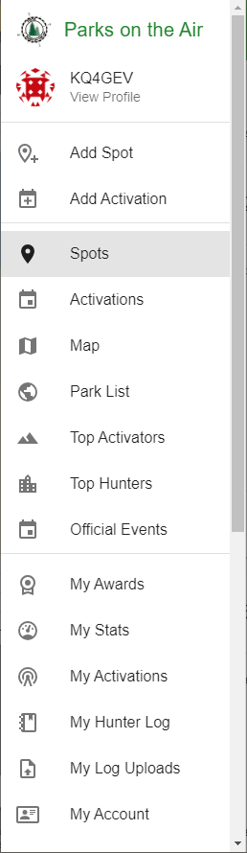
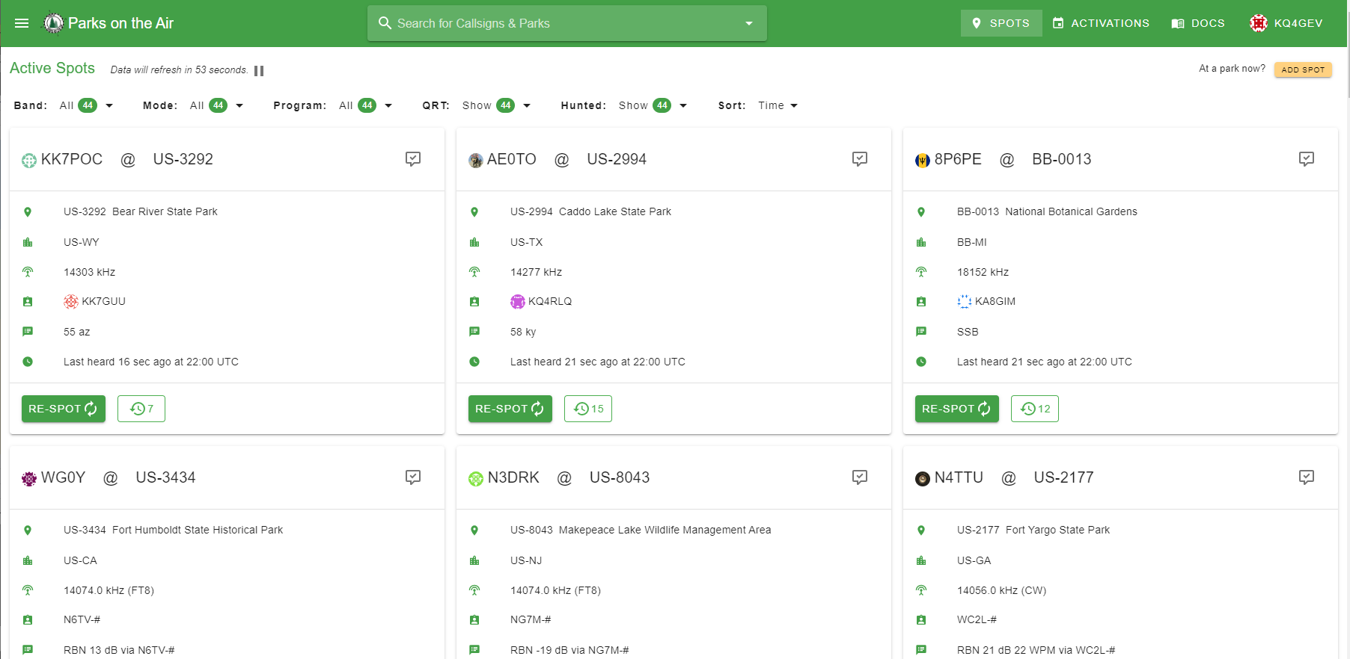

Hunting
Sign into the POTA app and locate the “Spots” page

Slide 6
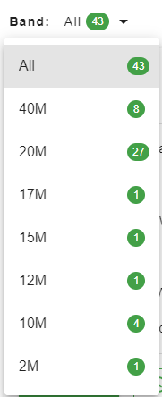
Hunting
Band selection filter

Slide 7
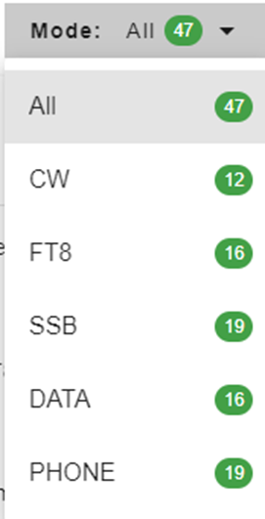
Hunting
Mode selection filter

Slide 8
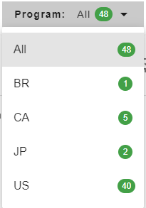
Hunting
Program (country) selection filter

Slide 9
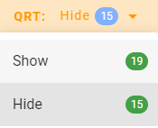
Hunting
QRT selection filter

Slide 10
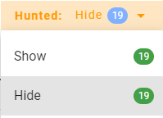
Hunting
Hunted selection filter
Hunted (Hide) - If set to hide a re-spot will make the park disappear from the Sort list.
Hunted (Show) - If set to show a re-spot will make the park turn gray in the Sort list.

Slide 11
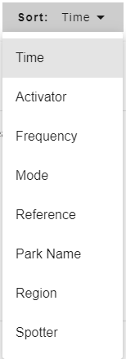
Hunting
Sort options

Slide 12
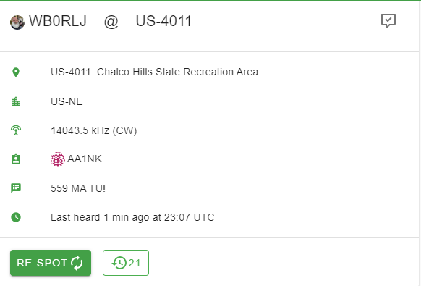
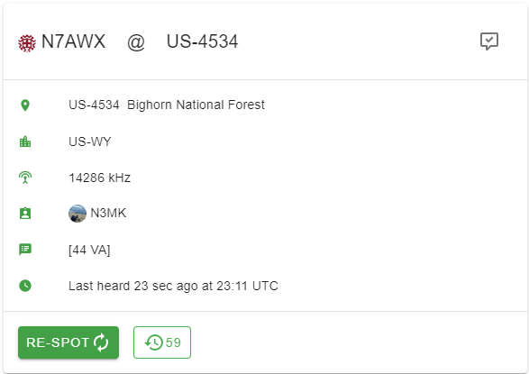
Hunting
Activator and park number
Park number and name
Click for park details
Park state or province
Spin your VFO to here listen. Be prepared to provide a signal report and state if you make a contact.
Callsign of last spotter
Spotter comment

Slide 13
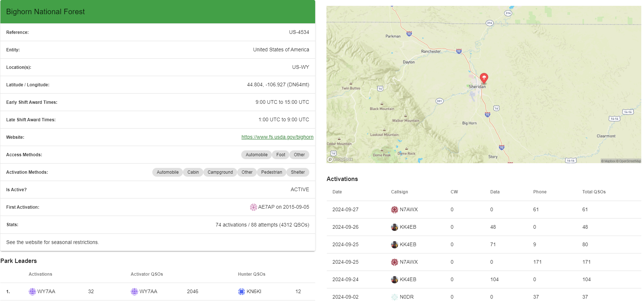
Hunting – Park details

Slide 14
Hunting – Making a contact (example)
Activator: CQ POTA CQ POTA This is Kilo Quebec 4 Golf Echo Victor at US-4534, Bighorn National Forest, Wyoming, calling CQ POTA and standing by.
Hunter: Kilo Xray 4 Bravo Yankee
Activator: Kilo Xray 4 Bravo Yankee, QSL?
Hunter: QSL, you are 5-8 into Alpha Lima
Activator: Roger, you are 5-9 into my park US-4534
Hunter: Good luck with your activation, 73!
Activator: Thanks for hunting, 73! Kilo Quebec 4 Golf Echo Victor QRZed
Notes:
Have Ken perform the exchange with me without asking – liven the group up a bit.

Slide 15
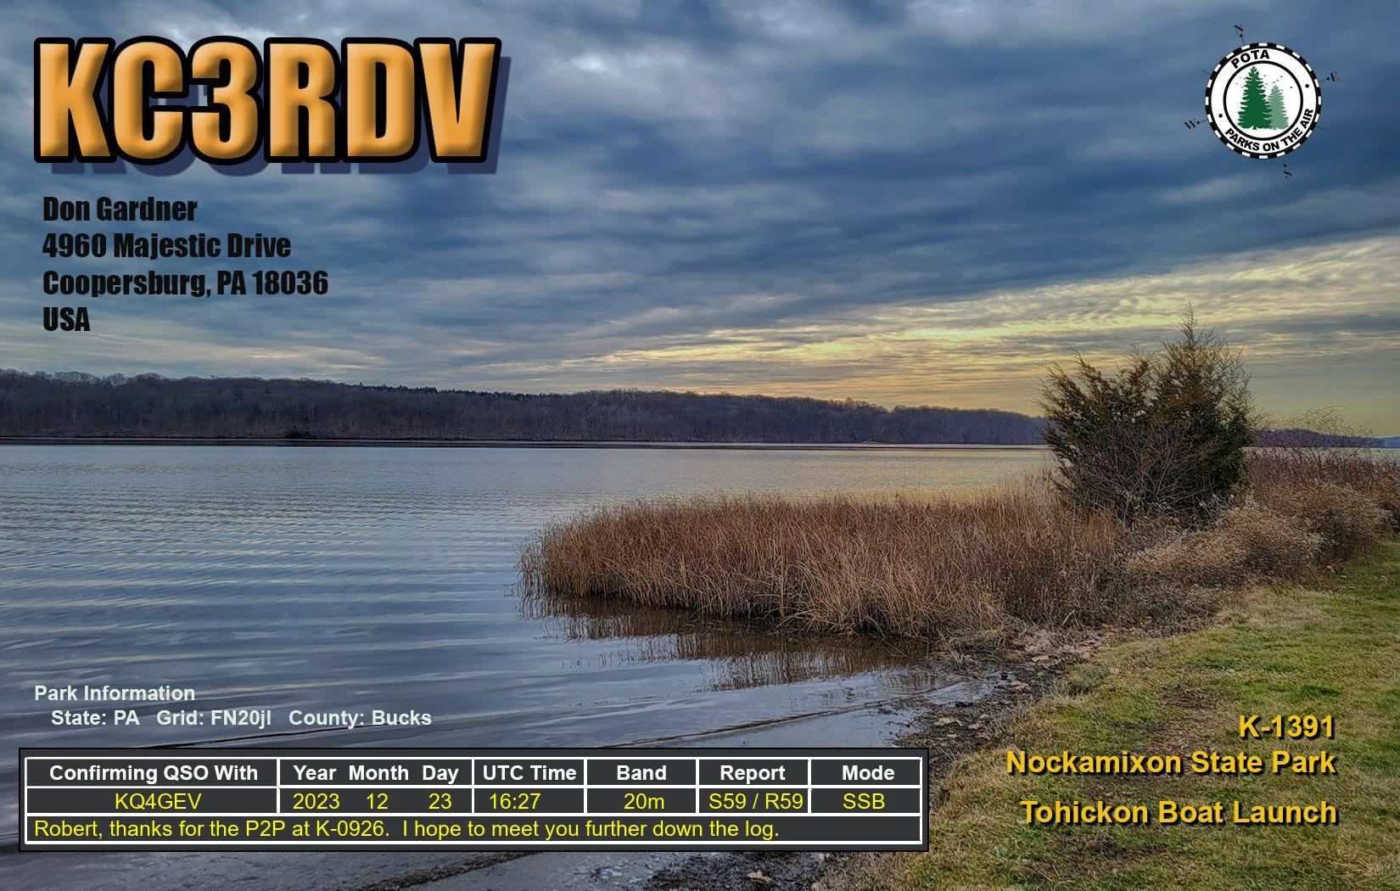
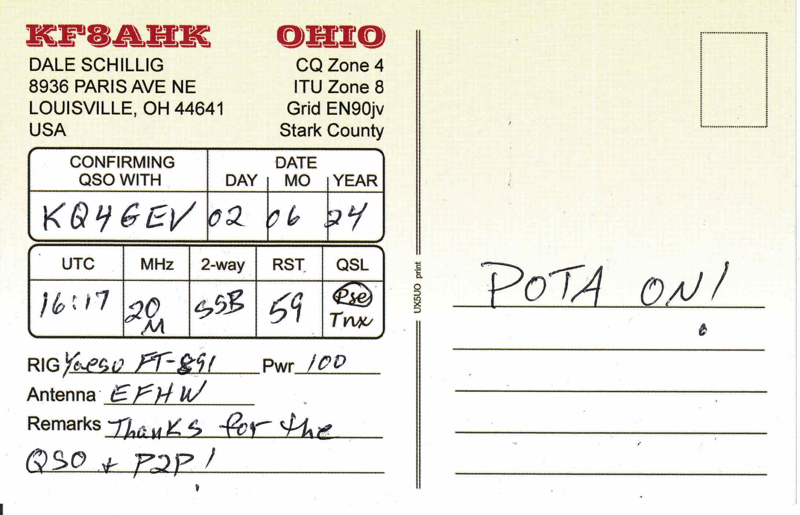
Hunter - Logging
“As a hunter, you do not submit any logs to POTA. However, it would be best if you still kept a log for your station. It is also recommended to upload your log to LoTW, QRZ, ClubLog, eQSL, or any other online confirmation service. In particular, LoTW is used by most award hunters.”
“The POTA system works based only on the logs submitted by the activators.”
Many POTA participants load their logs to these other services for confirmation. It is also not unusual to receive electronic or paper QSL cards.
Quoted text from the POTA website

Slide 16
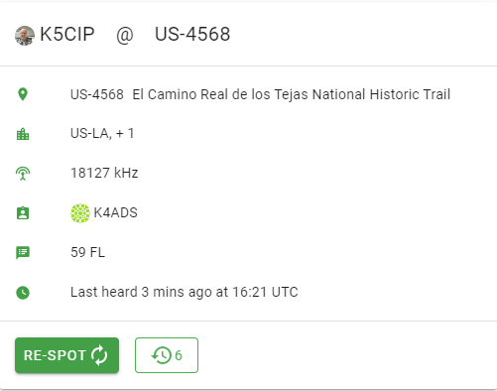
Hunting – RE-SPOT
If you are able to hear or contact an activator, you may want to “RE-SPOT” them.
Click the “RE-SPOT” button and enter a comment such as a signal report and your location, e.g., “59 FL” Your callsign will then appear in the spotter location.
Clicking on the clock symbol provides a history of spots.
0
0

Slide 17

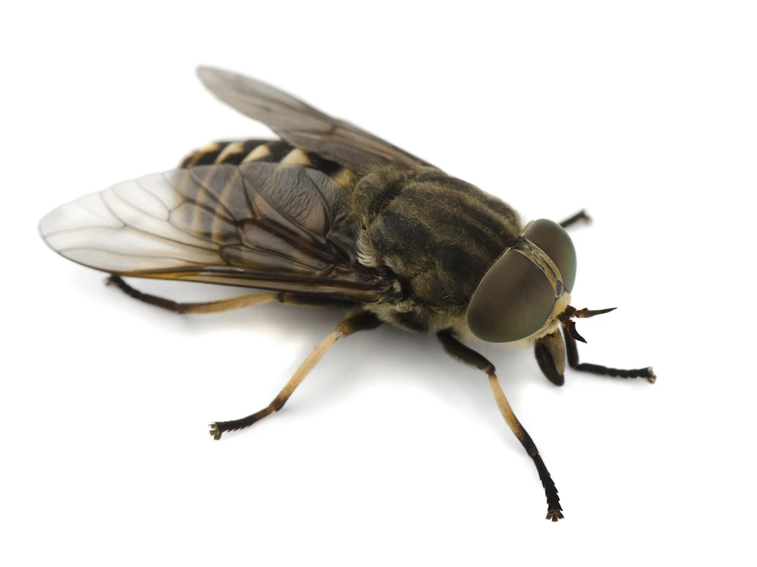
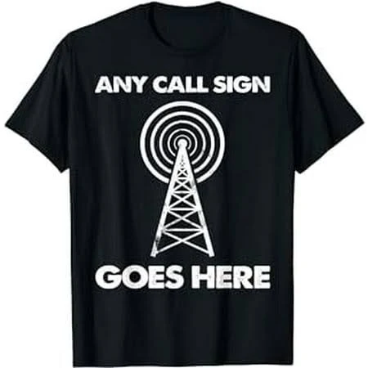
Activating – Make a list
Required:
Time – 10 contacts are required to “activate” a park.
Radio (mic & power cord)
Battery / Power source
Coax (necessary adapters)
Antenna and antenna support
  ¼ wave ground plane & radials
  ¼ wave dipole
  End-fed half-wave (EFHW)
Method of logging / Recorder
Recommended:
Bag of some type to carry your gear
Radio manual
QSO Template
Unun or Balun
POTA ID
Radio attire – hat, shirt, etc., with your call sign or other radio reference
Band plan
Water
Snacks
Hat
Sunscreen
Bug spray
First aid kit
POTA brochure(s)
Hambadgers.com
Notes:
Antennas:
¼ wave ground plane is the only self-supporting system tripod & painters tape or rope and arborer's line)
– you may not always be able to park at the location from which you plan to operate

Slide 18
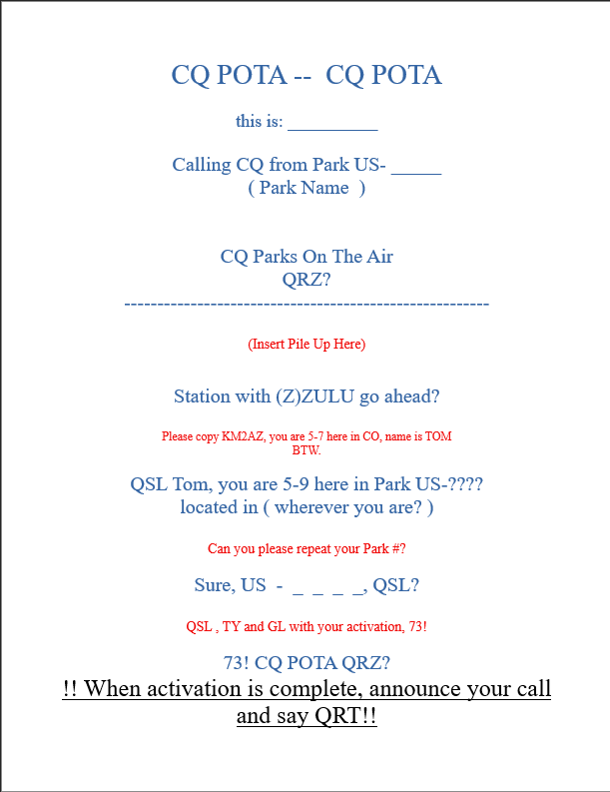
Activating - Consider a QSO Template
For your first few times out you may want to write out what you want to say.
Each QSO is different.
Everyone has a different style.
Thanks to KX4BY for providing the template!

Slide 19
Activating – Know the Rules
Follow the law
Follow the DX Code of Conduct
Follow the Golden Rule
Leave no trace
Follow any instructions from park rangers you encounter
Be courteous of the public space you are using
You must have an account registered at https://pota.app
You and all your equipment must be within the boundaries of the park(s)
You must submit an ADIF log after your activation is complete.
Follow the Rules detailed here (https://docs.pota.app)
Notes:
Do’s and Don’ts.
Do be a good ambassador for POTA and Ham Radio.
Do share your enthusiasm with the public and park officials.
Do thank park officials for use of the park.
Do leave the park area cleaner than you found it.
Do clarify if the park is a historical site and requires any special considerations?
Do not block or impede trails, footpaths, or access to facilities.
Do not damage any trees or structures during deployment.

Slide 20
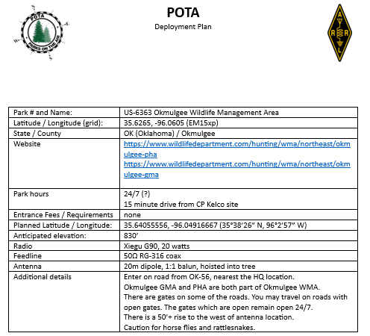
Activating – Before you go
Park number and name
Maidenhead grid location (in large parks the actual grid in which you setup may be different)
State and county
Park hours
Entrance fees / requirements
Anticipated elevation
Potential locations for the antenna type you want to deploy

Slide 21
Activating – UTC Time Considerations
Be aware of UTC time as you plan your activation. As all amateur radio logging occurs, POTA uses UTC time for start and ending a day. This can work against you or in your favor.
If you begin your activation just before the end of the UTC day, be sure to get your 10 contacts in before the day rolls over. Otherwise, you will not have enough contacts to activate that specific day.
If you begin your activation just before the end of a UTC day and get your 10 contacts before the day rolls over, consider staying around and making another 10 contacts after the day rolls over. That gives you two activations for only one deployment!

Slide 22
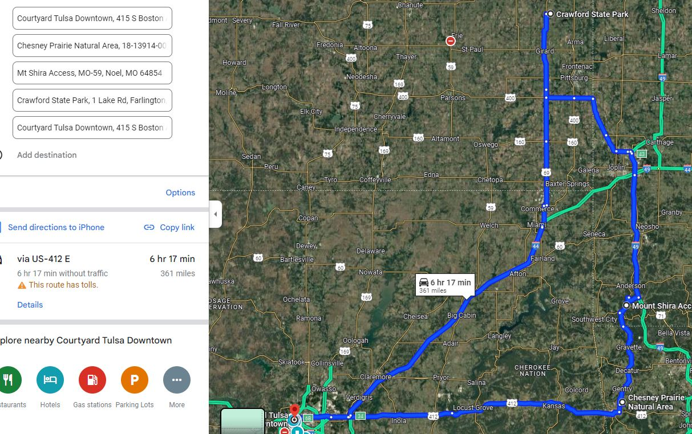
Activating – Before you go
US-7402 & US-1333
US-11140
US-2333
4
NEW
PARKS!
US-7402 & US-1333
3
NEW
STATES!
US-2333
US-11140

Slide 23

Activating – Upon arrival
When visiting a park where you have not previously operated, you should consider stopping by the ranger station or visitor center and have a chat with the staff.
This is an opportunity to be a good ambassador for amateur radio and POTA. Don’t take it for granted that the staff knows about the POTA program. They likely do not.
Share your plans for antenna deployment. Some sites are historic in nature and don’t allow you to dig into the ground or hang antennas from trees. Share your “Leave no trace” mantra.
Auburn alumna Lisa Hendy, the first woman to serve as chief ranger of the Great Smoky Mountains National Park.
Hendy graduated from Auburn University in 1994, majoring in Park and Recreation Management.
Since graduation, she has served at national parks including at Yellowstone and the Grand Canyon. Before being tapped the first woman to serve as chief ranger for the Smoky Mountains National Park in 2019, she was Chief Ranger at Big Bend National Park in Texas.

Slide 24
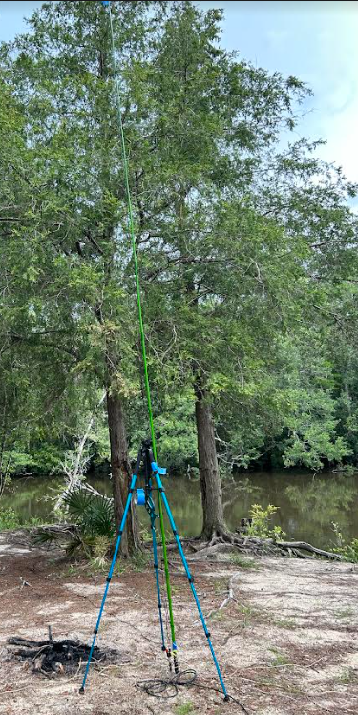
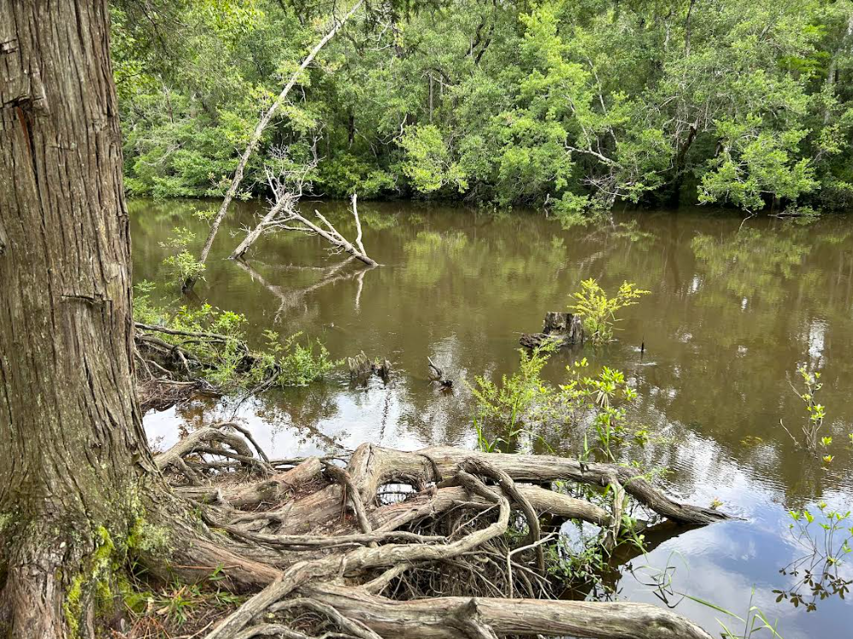
Activating – Setting Up
Ensure you are withing the park boundary https://pota.app/#/map – Allow location services to quickly zoom to your location, or use the drop-downs to choose an entity and location.
Safety – Keep clear of pedestrian pathways. Remember, the park isn’t your personal property.
Critters
Hunters
Let someone know where you are
Weather – Take a quick look at the weather for your area, including the SPACE WEATHER
Photos – Take some photos of your deployment area, antenna, and radio setup. These can be useful for future presentations!
Car operation – Remember you can always bring your coax in through a window and operate within the vehicle. RFI caution if engine running.
Gator pit?

Slide 25
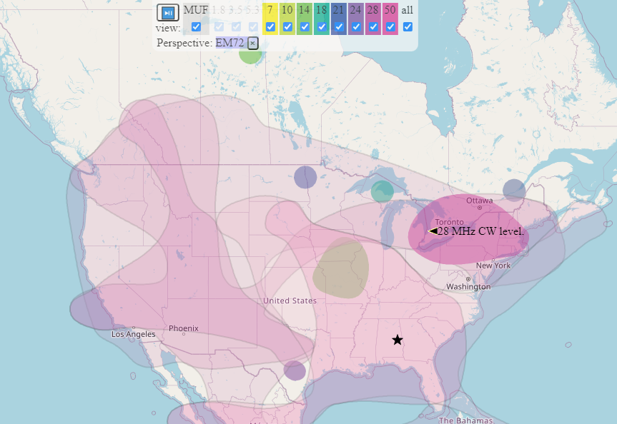
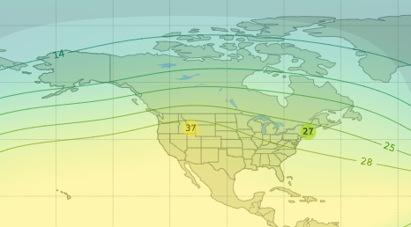

Activating – Getting Ready to Press the PTT
Consider looking at the radio operating conditions. Don’t let this deter you from activating, but this can help you understand the conditions you are up against.
Operating bands / propagation maps
MUF
Space weather (next slide)
Actual longitude and latitude
Elevation
WebSDR

Slide 26
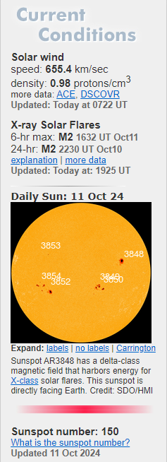
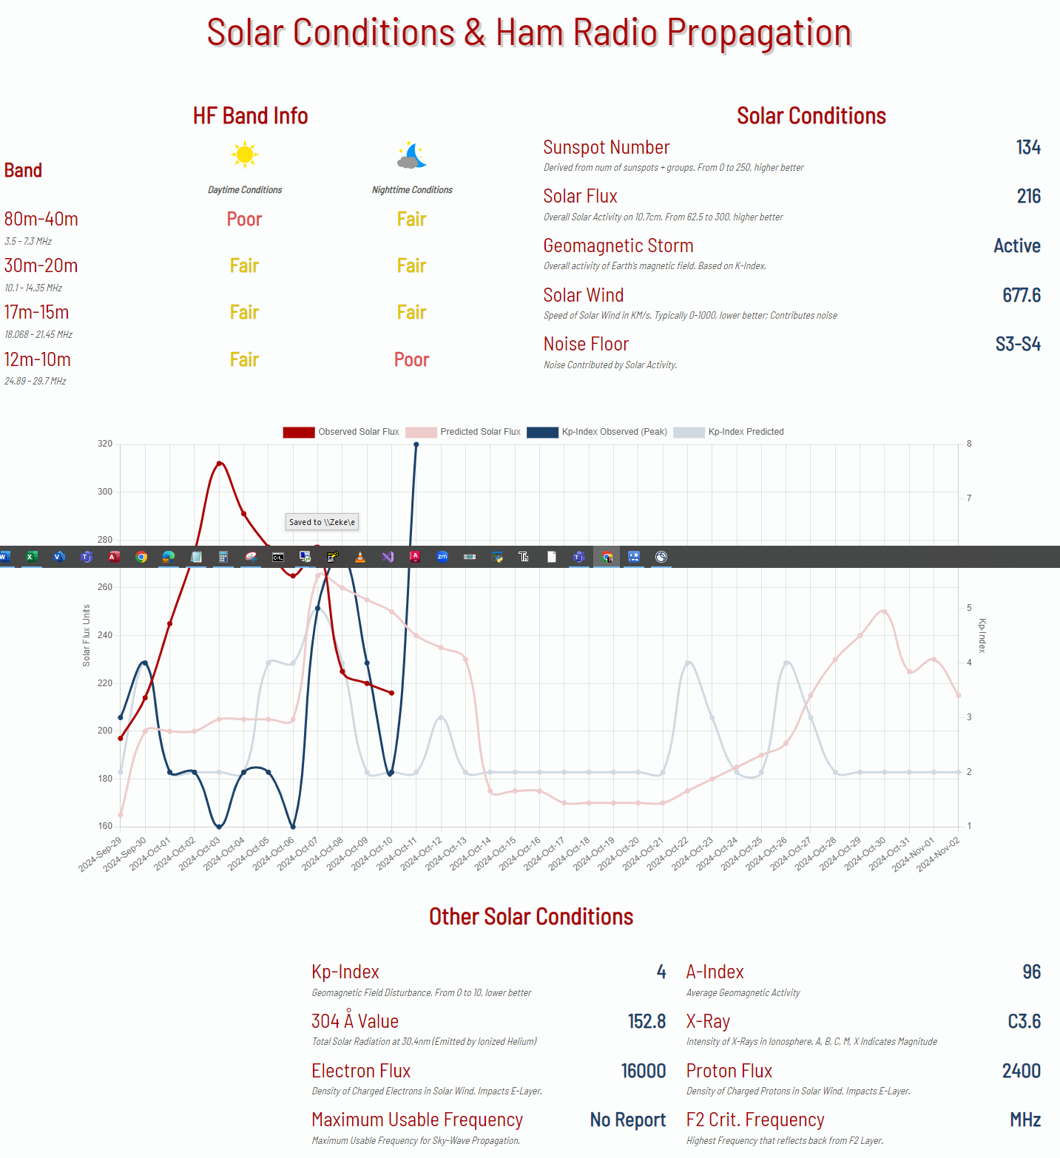
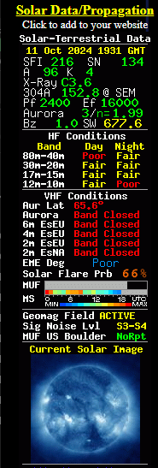
Activating – Space Weather
These 3 screenshots were taken within 5 minutes of one another.

Slide 27
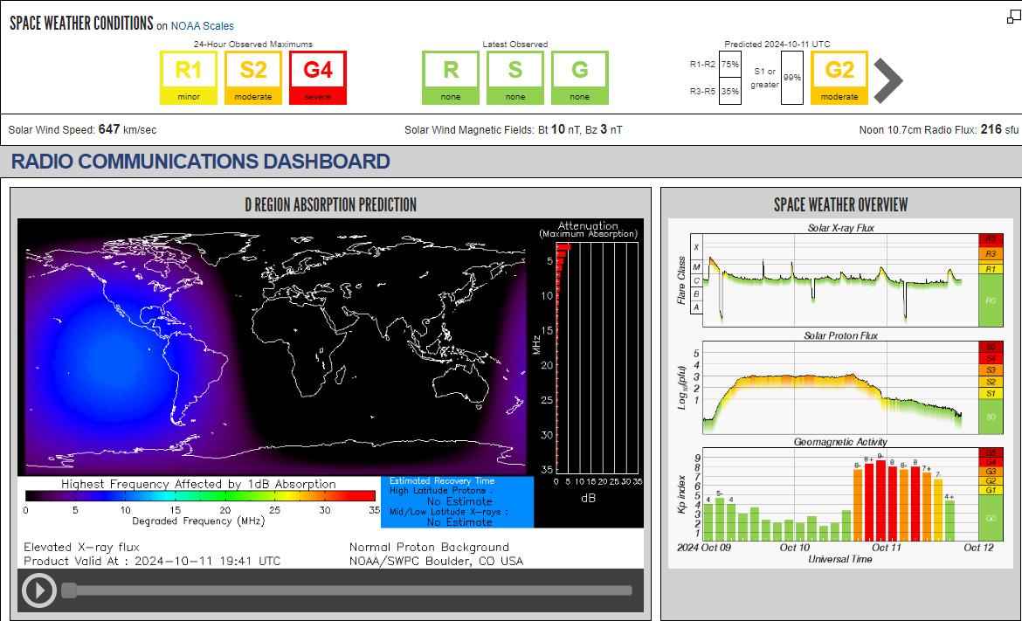
Activating – Space Weather

Slide 28
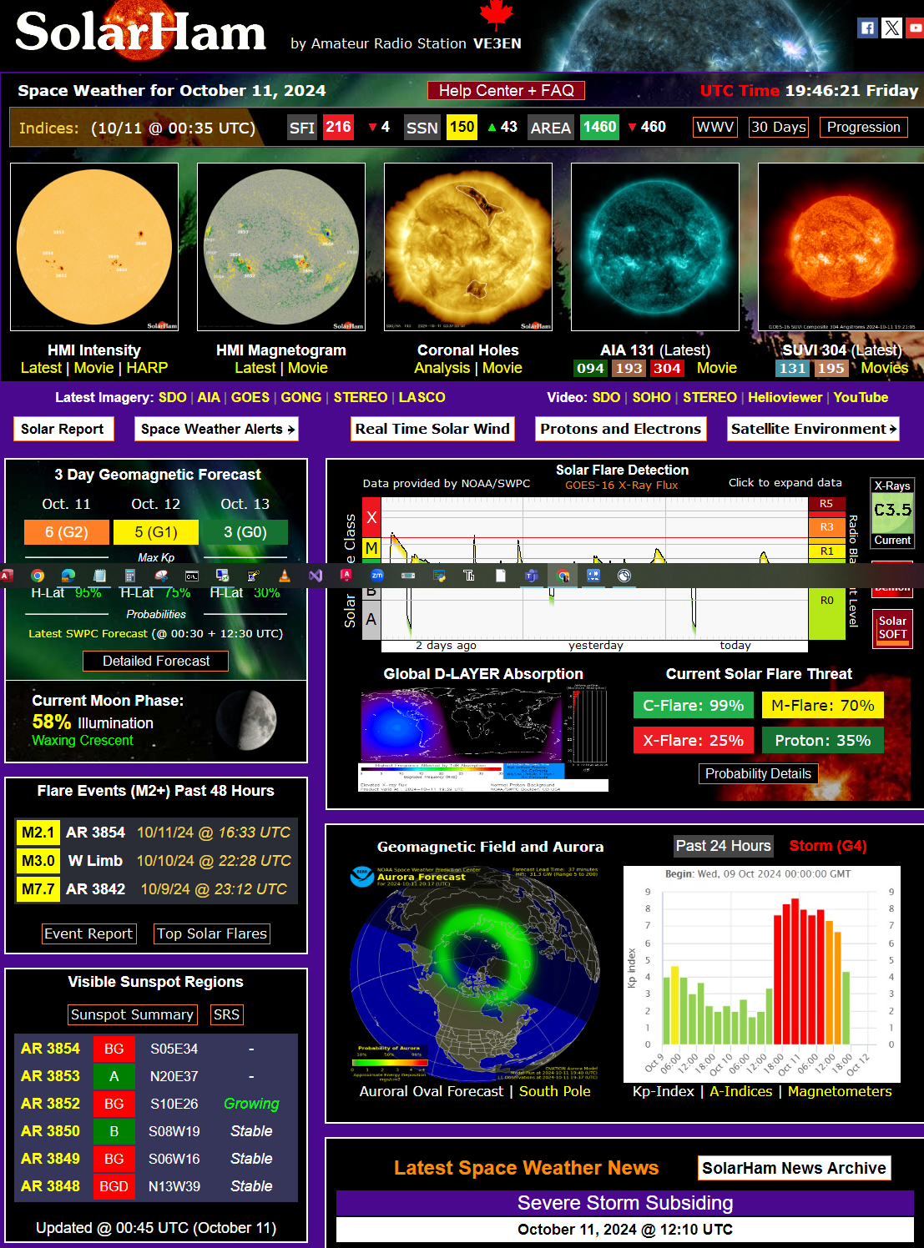
Activating – Space Weather
The charts and sources have come a long way.
Informative
Colorful
Interesting
DON’T LET THIS EVER STOP YOU FROM GETTING OUT AND OPERATING!

Slide 29
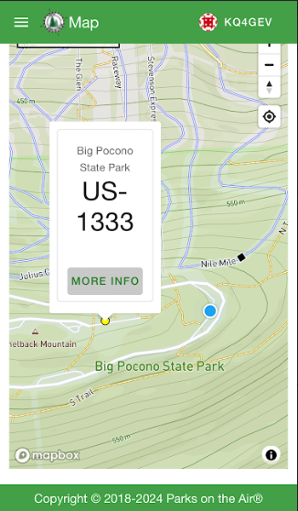
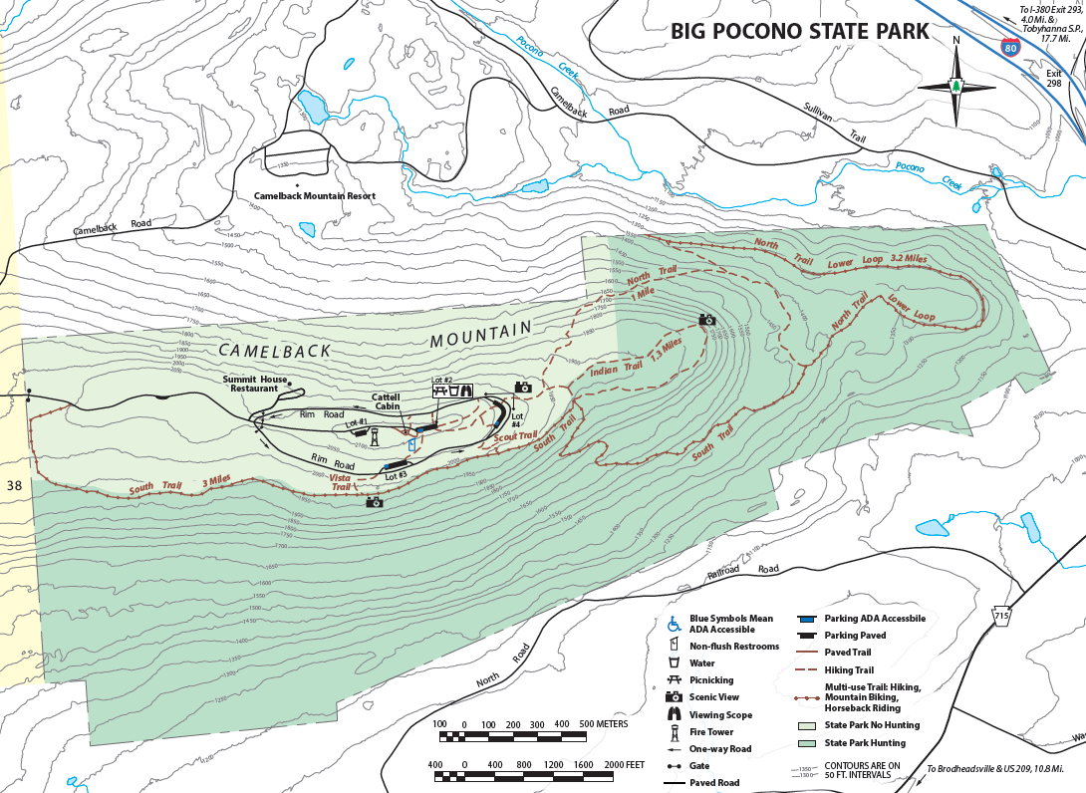
Activating – Park Boundaries, Easy
“The yellow dots are approximate locations of parks in your area. Check official sources (park websites etc.) and ensure you are within the park’s boundary.”
Quoted text from the POTA website

Slide 30
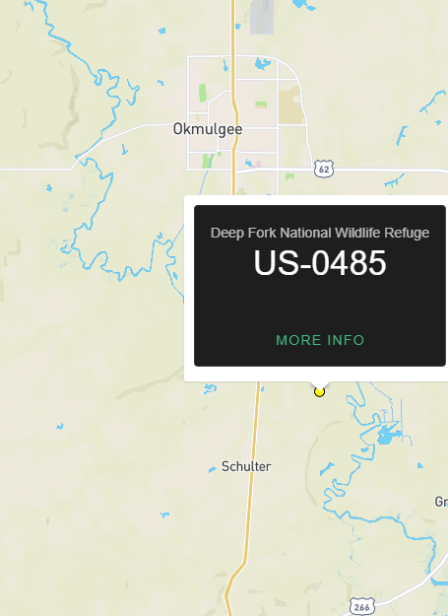
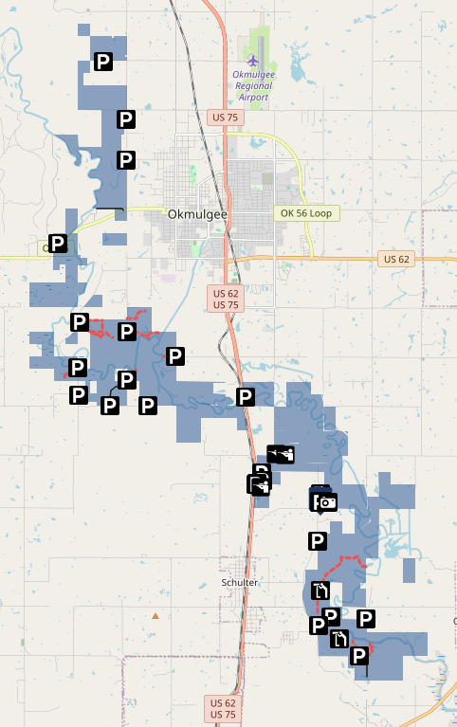
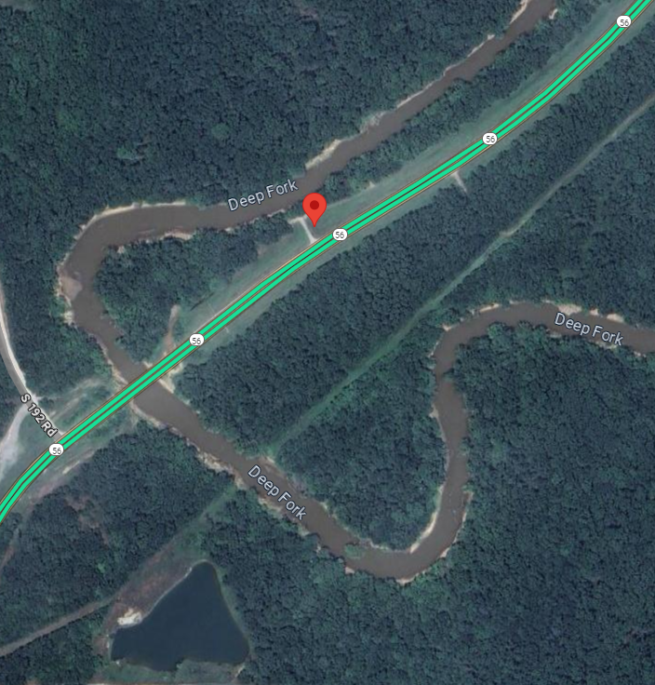
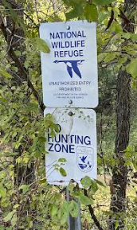
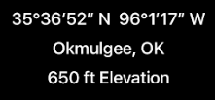
Activating – Park Boundaries, Difficult
Photo
POTA Map – Yellow dot
Google Maps location by recorded coordinates
Deep Fork National Wildlife Refuge Map

Slide 31
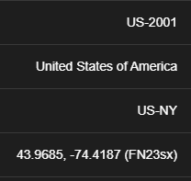
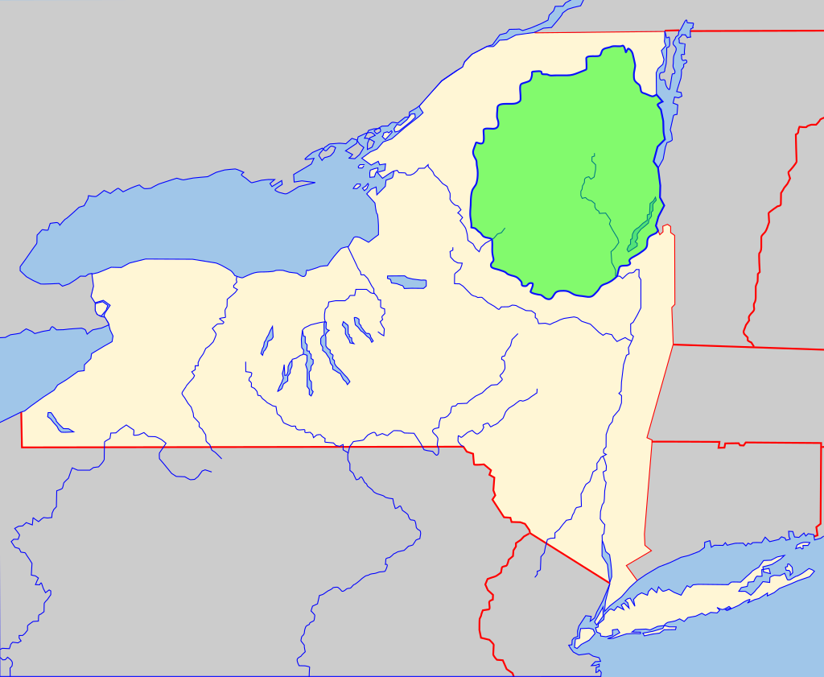
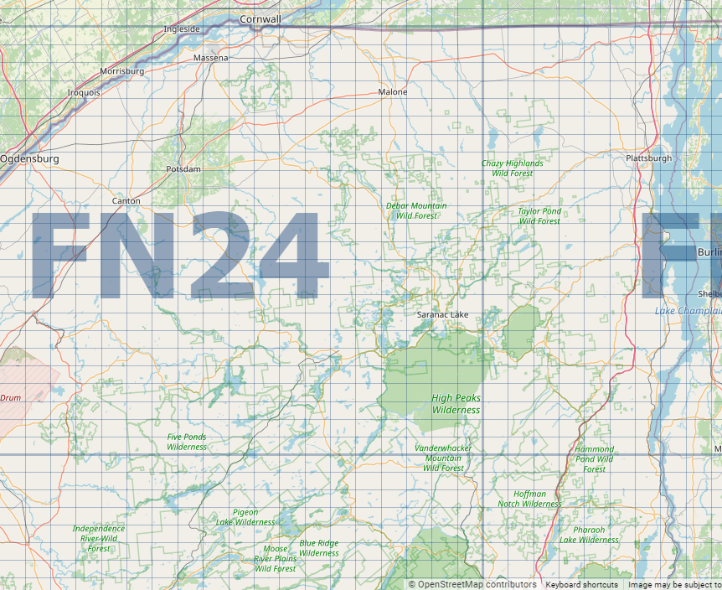
Activating – Grid Squares e.g. US-2001, Adirondack State Park
The grid square noted by POTA may not be the grid square you are operating within.
FN23 is below FN24
Adirondack Park
This 6 million acre park is the largest publicly protected area in the contiguous United States. It's larger than Yellowstone, Everglades, Glacier, and Grand Canyon National Park combined.
Repeaterbook APP (on your phone) and https://www.qrz.com/gridmapper
are good resources for determining your grid square.

Slide 32
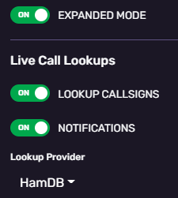
Activating – Preparing to Press the PTT
Choose your logging software. – Unless you are proficient with something other than HAMRS, this is the recommended tool. It’s free and intuitive. Did I mention free?
Configure any required settings or templates – Whatever software you choose, there are likely settings to be adjusted and, perhaps, templates which can be used.
Find a frequency – using the POTA APP and LISTENING, determine a vacant frequency area. (Proficient operators know to consider their transmitting bandwidth.)
Spot yourself (ADD SPOT) with the POTA APP and get ready!

Slide 33
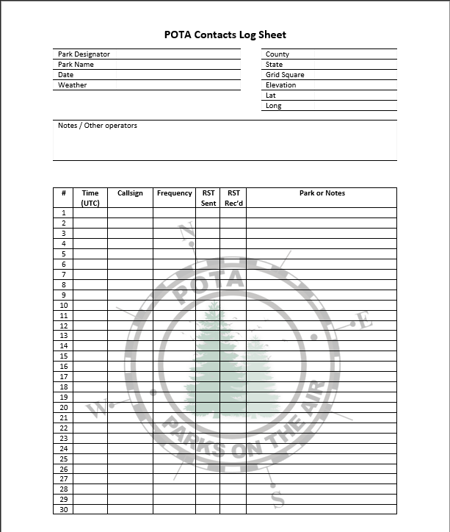
Activating – Paper Logging
This is one of those “just because you can doesn’t mean you should” kind of situations.

Slide 34
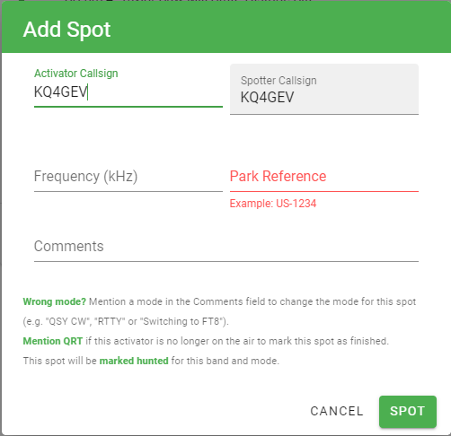
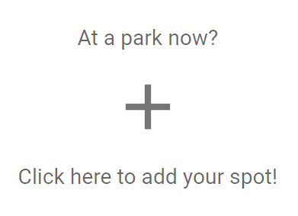
Activating – Spotting Yourself
The box below will appear at the bottom of the spotting page provided you are logged into POTA. Click and the window to the right pops up.

Slide 35
Activating – Park to Park
If this is your first time to try an activation, you may want to try to contact other parks. This is a hybrid HUNTER-ACTIVATOR scenario, but since you are at a park, you are technically activating.
“Troll” through the POTA spots on the POTA APP or within HAMRS. (HAMRS may run a little behind the APP or may not be available if you have no internet connection.)
When you find a station you can hear, wait for an opportunity and then pounce! Remember, you are fighting a potential pile-up.

Slide 36
Activating – Final Thoughts
Ten contacts are required to activate a park. Is it a big deal if you don’t activate? No. However, you should upload your log regardless of the number of contacts you made. (Unless you made none. ☹)
Do you want to stop at 10? I don’t.
It takes much longer to get 10 contacts by hunting while within a park instead of spotting yourself and calling CQ POTA!
If you are an Amateur Extra, you may want to start your activation in the Extra bands to avoid huge pileups and work at a less hectic pace.
At completion of your activation, RE-SPOT yourself and put “QRT” in the comment to indicate you have completed your activation.

Slide 37
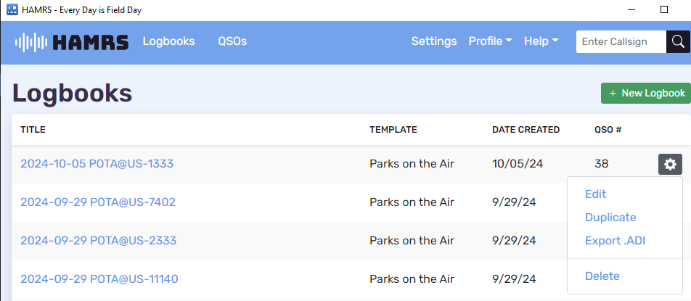
Submitting Your Logs
From HAMRS, change your view to the Logbooks page. Then click on the settings / gear wheel corresponding to the logbook you want to export. Then click “Export .ADI”

Slide 38
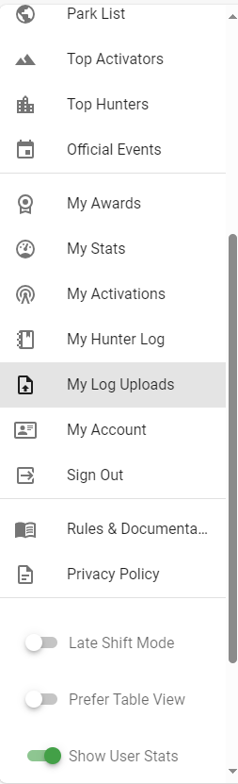
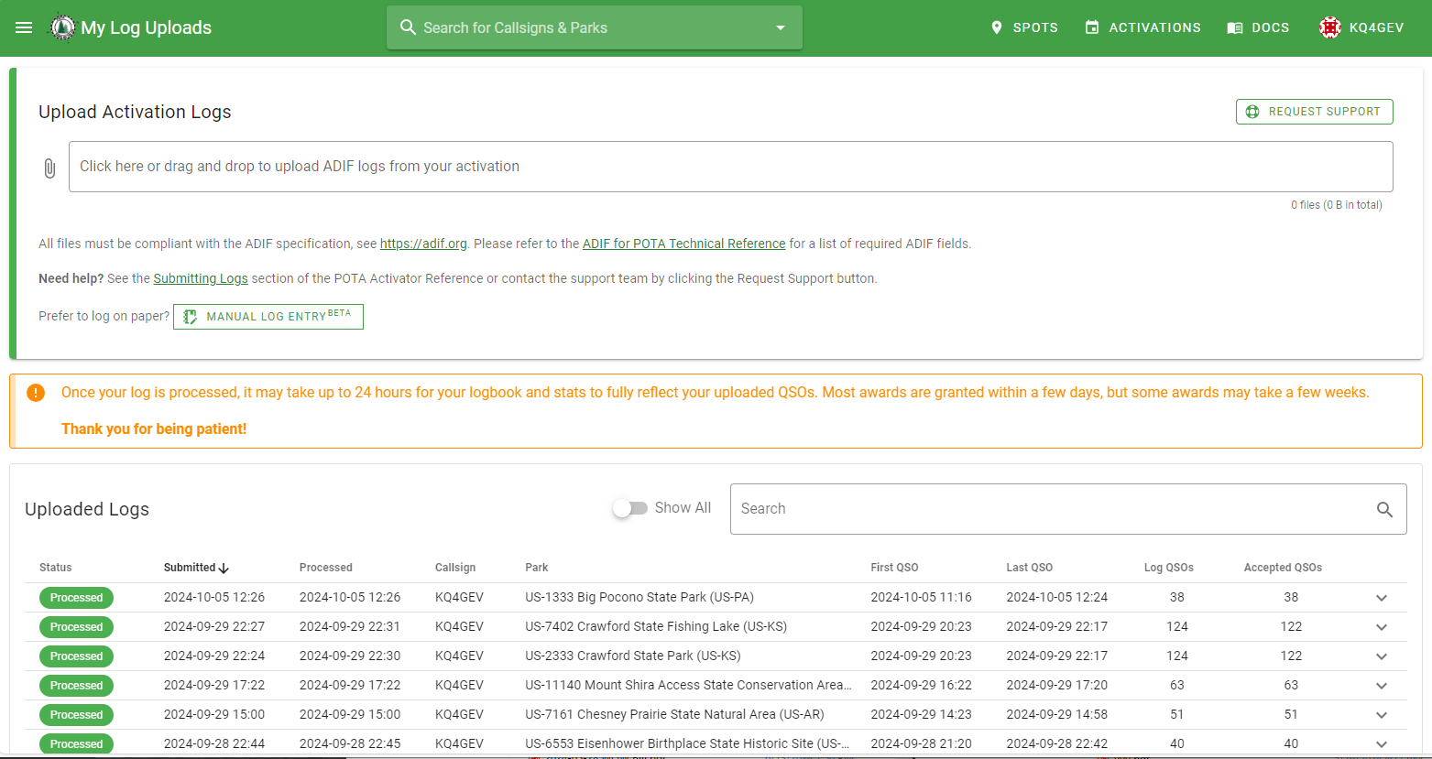
Submitting Your Logs
Within the POTA app locate the “My Log Uploads” page

Slide 39
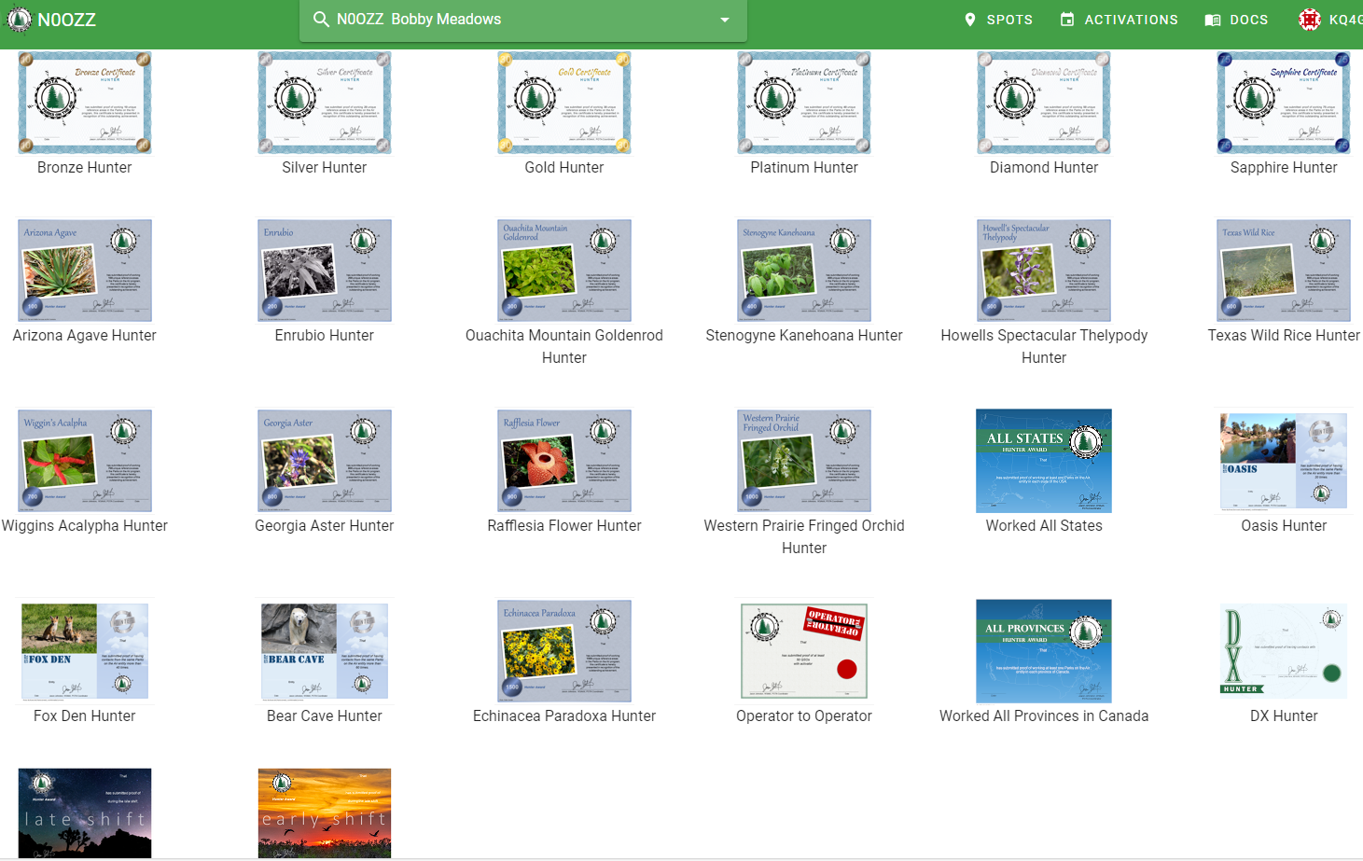
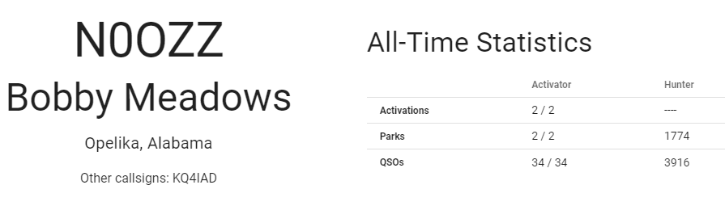
Awards
“Parks on the Air recognizes your dedication with awards available to Activators and Hunters:
To get yours, just Login and go to My Stats and Awards Issued. Click on the award link to download it. We are currently adding more awards that are not available there yet, so that you can download them at any time.”
Quoted text from the POTA website

Slide 40
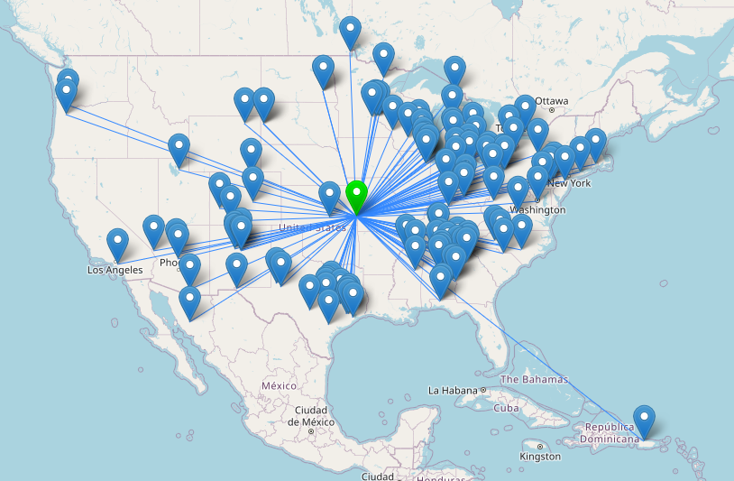
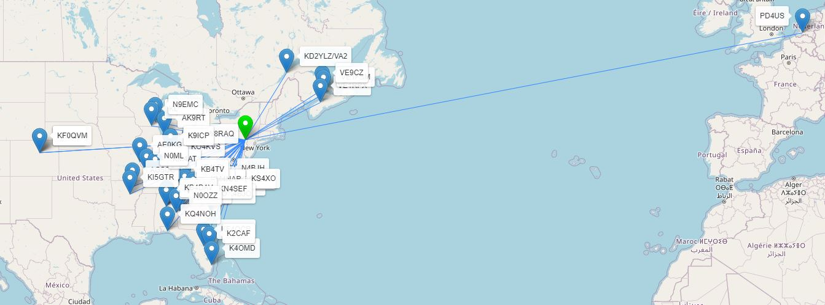
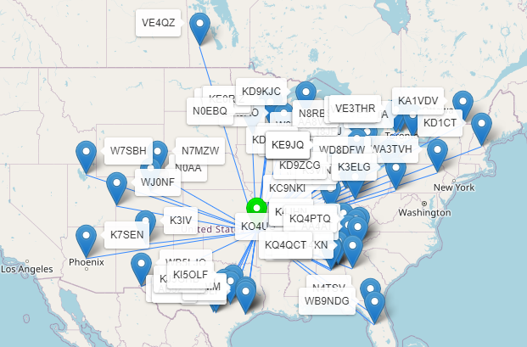
Mapping Your Contacts

Slide 41
POTA Communications
Other communication platforms for POTA activities you may want to examine:
Discord
Reddit
Slack
Facebook
X

Slide 42
POTA Optimization
Make items as few and small as possible:
Radio (mic & power cord), consider the Xiegu G90 20W
Battery / Power source, consider the Bioenno 8AHr LiPO4
Coax (necessary adapters), consider RG-316 with BNC connectors
Antenna and antenna support
  ¼ wave ground plane & radials, #22 AWG wire plus 7m fishing pole
  ¼ wave dipole, some string and throwing weight
  End-fed half-wave (EFHW), also some string and throwing weight
Method of logging / Recorder, work laptop (maybe?)

Slide 43





POTA Optimization – What it looks like
The left reel contains
BNC to banana plug connector
16.5’ of #22 AWG for active element
16.5’ of #22 AWG radials, quantity 8 (132’)
The right reel contains 50’ RG-316 coax

Slide 44



POTA Optimization – What it looks like
7-day business trip, 3 antennas & fishing pole
Battery is in a “fire and explosion proof” bag
5-day business trip
#16 AWG dipole

Slide 45
Domestic Air Travel – Carry-on Luggage
Always, always, always, check with your airline and current TSA and FAA web sites for the latest regulations.
Be prepared for your bag(s) to be inspected. BE COURTEOUS!
Batteries are the primary concern. See the FAQ
Lithium ion batteries (a.k.a.: rechargeable lithium, lithium polymer, LIPO, secondary lithium). Passengers may carry all consumer-sized lithium ion batteries (up to 100 watt hours per battery). External chargers are also considered to be a battery.
To determine watt hours (Wh), multiply the volts (V) by the ampere hours (Ah). Example: A 12-volt battery rated to 8 Amp hours is rated at 96 watt hours (12 x 8 = 96). For milliamp hours (mAh), divide by 1000 (to get to Ah) and then multiply by the volts.

Slide 46

WHY?
A 7-day business trip netted:
769 contacts
11 activations
4 new states
6 new parks!
(I had already activated US-6363 in OK before this trip)

Slide 47
URL References
Register for a POTA account
https://parksontheair.com/
POTA “spots” page
https://pota.app/#/
POTA brochure
https://docs.pota.app/assets/documents/brochure.pdf
QRZ Grid Mapper
https://www.qrz.com/gridmapper
Operating bands / propagation maps
https://hf.dxview.org/perspective/EM72dt
MUF
https://prop.kc2g.com/
Solar conditions and Propagation
https://solar.w5mmw.net/
Solar data
https://www.hamqsl.com/solar3.html
Space Weather
https://spaceweather.com/
NOAA
https://www.swpc.noaa.gov/communities/radio-communications
Solar Ham
https://www.solarham.com/
POTA Log sheet
https://docs.pota.app/assets/documents/POTA_Logsheet_v1.2.pdf
Battery FAQ (FAA)
https://www.faa.gov/sites/faa.gov/files/hazmat/packsafe/resources/Airline_passengers_and_batteries.pdf

Slide 48
Source References
Szewczyk, Kimberly (2016-06-18). "National Parks on the Air - Women's Rights National Historical Park (U.S. National Park Service)". National Park Service. Archived from the original on 2022-10-20. Retrieved 2022-10-20.
^ "NPOTA Participation Leads to Inaugural Communication Detail for National Park Service". American Radio Relay League. 2017-01-27. Archived from the original on 2022-10-20. Retrieved 2022-10-20.
^ "It's World Amateur Radio Day!". American Radio Relay League. 2016-04-16. Archived from the original on 2022-10-20. Retrieved 2022-10-20.

